Slide 1
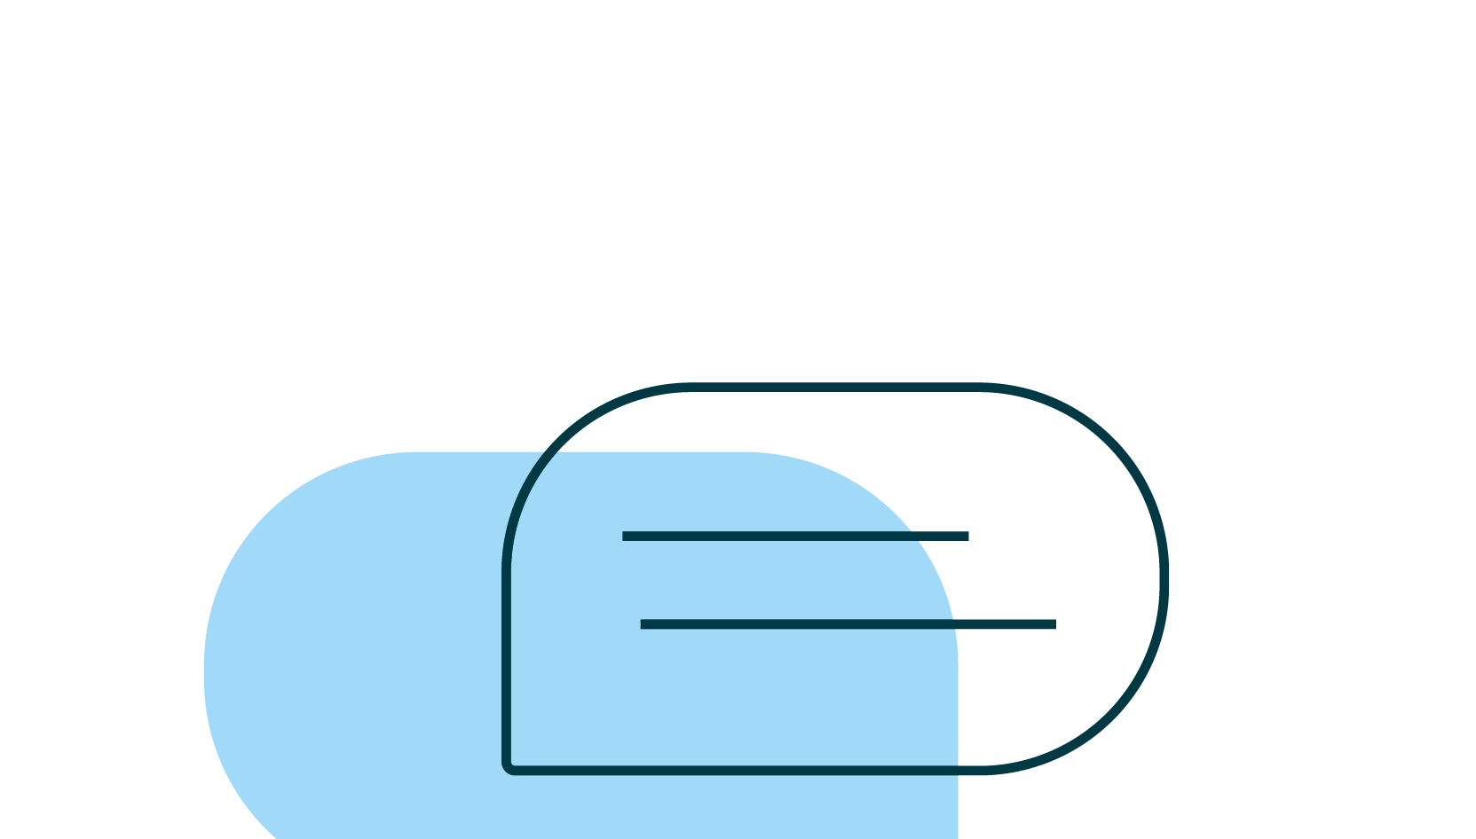
Argumentation with integrity
Lesson 2: Beginning preliminary research and crafting a claim
© 2022 Turnitin LLC. All rights reserved.
© 2021 Turnitin LLC. All rights reserved.
Notes:
Educator focus: Beginning preliminary research and crafting a claim

Slide 2
Argumentation and the writing process
1 Choose a topic
2 Refine the topic
3 Begin preliminary research
4 Craft a claim
5 Locate and evaluate resources for credibility and inclusion of logical fallacies
6 Choose only the most credible sources
7 Record citations for all sources
8 Plan and draft your essay
9 Edit and revise your essay
© 2022 Turnitin LLC. All rights reserved.
Notes:
Educator notes:
This slide is an overview to help you review the basics of argumentation and the writing process with students.
Argumentation academic vocabulary linked here. You may wish to give students a copy for easy reference or post in an online class/website. You may wish to have students complete a preliminary vocabulary activity such as a Frayer model to make certain that students have a common understanding of the terms. Ideally they could then be posted in the room for easy reference.
Discuss each step of the process in terms of your current project and how students can work through each step of the process in your class. Consider revisiting the Argumentation writing process checklist with students at the beginning of each lesson.

Slide 3
Argumentation with integrity: Lesson 2 objectives
Students will complete preliminary research.
Students will be able to differentiate between a thesis statement and a claim.
Students will be able to craft a claim.
Students will be able to use appropriate academic vocabulary as required by classroom activities.
© 2022 Turnitin LLC. All rights reserved.
Notes:
Educator notes: Review learning objectives -- if appropriate, add the content standards that match the objectives

Slide 4
How does an opinion develop into a claim?
© 2022 Turnitin LLC. All rights reserved.
Notes:
Educator notes: Consider using this slide as a lesson starter to assess what students know about this at the beginning of the lesson OR as a formative assessment later in order to determine if the concept needs to be revisited after students have completed the lesson. If displaying this presentation to a whole class, record responses from students on this slide. Another option would be for students to work in collaborative groups to define, discuss, and create examples before sharing with the larger group. Remote option: share this slide with students and have them record their answers on it.

Slide 5
Can you prove it? Begin preliminary research
Why does this step come before actually formalizing the claim for your essay?
An effective argument depends on the writer being willing to base the claim--the basis for their argument--on research that backs up that claim.
When a writer starts with the claim and then researches, they risk only using sources that they agree with to back up their “claim,” rather than basing the claim on the research--in other words, they make sure they only find evidence that they agree with rather than finding evidence that truly proves the claim.
© 2022 Turnitin LLC. All rights reserved.
Notes:
Educator notes: This is a good place to discuss how providing credible evidence in support of your claim is one way to demonstrate academic integrity when developing an argument. If you haven’t previously introduced the idea of source credibility previously, you may wish to reference the following resources: https://www.turnitin.com/resources/source-credibility

Slide 6
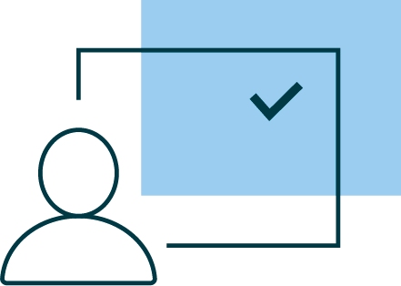
What do I already know?
As you begin researching your topic, consider the following:
What do I know about this topic?
What opinion do I have about the topic?
What are the different supports for the topic?
What are the different supports against this topic?
How much evidence is there in support of/against the topic?
Can I use this information to form an arguable claim?
© 2022 Turnitin LLC. All rights reserved.
Notes:
Educator notes: Model this process and then, once students have started/completed preliminary research on their topic, have them respond on the graphic organizer Lesson 2 graphic organizer: What do I already know? -- this will help them to organize their thoughts regarding what information is available to them and will be useful in writing their claim so they can start building their thesis statement surrounding the available evidence.

Slide 7
What do I already know about criminal justice reform?
People are not always treated the same in courtrooms → people should be treated fairly in courtrooms, especially regarding setting bail for defendants. People who commit non-violent crimes should not be held to the same standards as those who commit violent crimes.
Reasons FOR my position
Penalties seem greater for poor defendants
Penalties seem greater for people of color
People who cannot pay bail sit in jail until the trial and are more likely to be convicted
Reasons AGAINST my position
People who commit violent crimes should not be allowed out on bail
Guidelines are in place to avoid unfair bail practices so it isn’t needed
© 2022 Turnitin LLC. All rights reserved.
Notes:
Educator notes: Continue with the example about criminal justice reform begun in Lesson 1. You can either add transitions to reveal each set of responses with the click of your mouse or delete the responses shown here and brainstorm with students so that they can come up with their own reasons.
Once students have started/completed preliminary research on their topic, have them respond on the graphic organizer Lesson 2 graphic organizer: What do I already know? -- this will help them to organize their thoughts regarding what information is available to them and will be useful in writing their claim so they can start building their thesis statement surrounding the available evidence.

Slide 8
Preliminary research
What next?
You have started with a topic
You formed an opinion about what stance you might want to take on that topic
You have completed preliminary research and determined that there is enough information to develop into an argument
Write your thesis statement
© 2022 Turnitin LLC. All rights reserved.

Slide 9
Thesis or claim?
A claim expresses the writer’s position towards the subject or topic of the essay. It is argumentative by definition.
Your claim establishes the focus and scope of the argument.
Support your claim by providing evidence in the form of quotations, expert opinion, statistics, and academic reasoning.
© 2022 Turnitin LLC. All rights reserved.
Notes:
Educator notes: Students may confuse the terms claim and thesis statement. Now may be a good time to supplement your instruction by using the the Lesson 2 worksheet: Thesis or claim. Examples of each can be found using Turnitin’s bank of exemplar essays or choosing examples from students’ own writing samples which may help to keep instruction meaningful for students. Choose strong, effective samples to illustrate what good claims look like. You may wish to choose some from the 1 or 2 score range so that you can help students practice adding the type of information and details which will make it a stronger claim statement.

Slide 10
Craft a claim
A claim expresses the writer’s position towards the subject or topic of the essay. It is argumentative by definition. Your claim establishes the focus and scope of the argument. Support your claim by providing evidence in the form of quotations, expert opinion, statistics, and academic reasoning.
A claim will be:
debatable with inquiry and evidence; it is not simply stating the writer’s opinion
narrow enough to argue within the scope of your essay (or other appropriate format)
specific with a strong focus
© 2022 Turnitin LLC. All rights reserved.
Notes:
Educator notes: the focus here is on claims as that is the language used for argumentation. The poster or worksheet Lesson 2 worksheet: Thesis or claim can be used in conjunction with this slide and the next to show explicit examples of each and demonstrate the essential differences between the two. It should be noted that they serve a similar but not exactly identical purpose in an essay, but the genre of the assignment determines the language used to speak about it.

Slide 11
Thesis or claim?
A claim will be:
debatable with inquiry and evidence; it is not simply stating the writer’s opinion
narrow enough to argue within the scope of your essay (or other appropriate format)
specific with a strong focus
Example: Libraries should serve all members of its community, not just a special few as books are the key to knowledge and independence.
1
2
3
© 2022 Turnitin LLC. All rights reserved.
Notes:
Educator notes: Students may confuse the terms claim and thesis statement. Now may be a good time to supplement your instruction by using the the Thesis or claim handout. More examples can be found there, as well as examples of thesis statements for comparison. Students can follow along using the Lesson 2 worksheet: Thesis or claim and keep that as a reference.
More examples of each for practice can be found using Turnitin’s bank of exemplar essays or using students’ own writing to make the examples more relevant to the work.

Slide 12
Thesis or claim?
A claim will be:
debatable with inquiry and evidence; it is not simply stating the writer’s opinion
narrow enough to argue within the scope of your essay (or other appropriate format)
specific with a strong focus
1
2
3
Example 2: Graffiti should be considered vandalism because it is illegal and costly to remove.
Example 3: Just taking short naps can help your health, provide more energy for your body and increase your knowledge and memory.
© 2022 Turnitin LLC. All rights reserved.
Notes:
Educator notes: These examples are from the Lesson 2 worksheet: Thesis or claim so that you can work with students to highlight and label the parts of a claim as they make those notes on their own copies, either digitally or on printed copies you have supplied. Copy the callouts from the previous slide and/or use the highlighting tool to model identifying the different parts for students. Multiple examples of thesis statements can be found on the handout too.
More examples of each for practice can be found using Turnitin’s bank of exemplar essays or using students’ own writing to make the examples more relevant to the work.

Slide 13
What steps can you take to narrow down your area of interest into a workable claim?
© 2022 Turnitin LLC. All rights reserved.
Notes:
Educator Notes: Consider using this slide as a formative assessment in order to determine if the concept needs to be revisited after students have completed the lesson. If displaying this presentation to a whole class, record responses from students on this slide. Another option would be for students to work in collaborative groups to define, discuss, and create examples before sharing with the larger group. Remote option: share this slide with students and have them record their answers on it.

