Slide 1
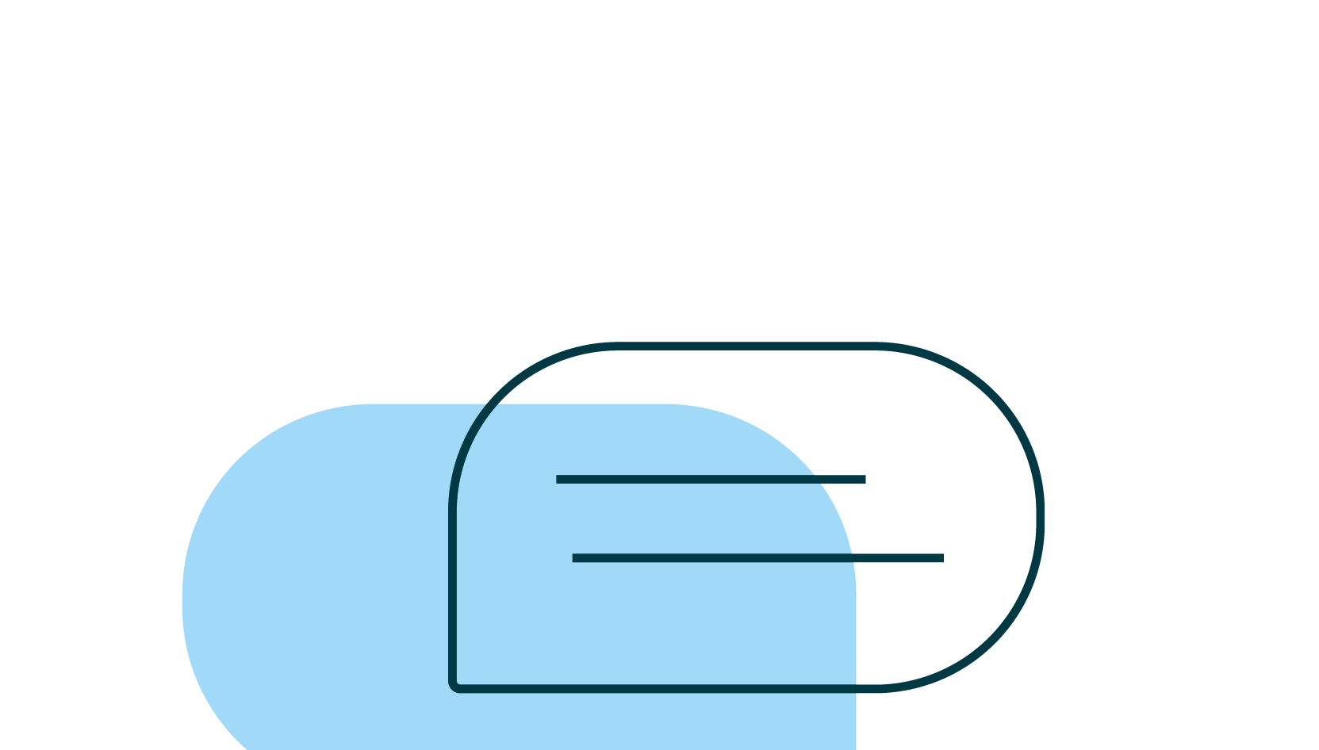
Argumentation with integrity
Lesson 3: Locating and evaluating resources
© 2022 Turnitin LLC. All rights reserved.
© 2021 Turnitin LLC. All rights reserved.
Notes:
Educator notes: Make the link to academic integrity explicit to students here: the credibility of their resources and citing them correctly is imperative if they wish to demonstrate academic integrity.
Educator focus: locating and evaluating resources for credibility, relevance and logical fallacies. Citing resources.

Slide 2
Argumentation and the writing process
1 Choose a topic
2 Refine the topic
3 Begin preliminary research
4 Craft a claim
5 Locate and evaluate resources for credibility and inclusion of logical fallacies
6 Choose only the most credible sources
7 Record citations for all sources
8 Plan and draft your essay
9 Edit and revise your essay
© 2022 Turnitin LLC. All rights reserved.
Notes:
Educator notes:
This slide is an overview to help you review the basics of argumentation and the writing process with students.
Argumentation academic vocabulary linked here. You may wish to give students a copy for easy reference or post in an online class/website. You may wish to have students complete a preliminary vocabulary activity such as a Frayer model to make certain that students have a common understanding of the terms. Ideally they could then be posted in the room for easy reference.
Discuss each step of the process in terms of your current project and how students can work through each step of the process in your class. Consider revisiting the Argumentation writing process checklist with students at the beginning of each lesson.

Slide 3
Argumentation with integrity: Lesson 3 objectives
Students will locate and evaluate resources for credibility and for relevance.
Students will identify logical fallacies in writing.
Students will record citations for all credible resources to be used.
Students will use appropriate academic vocabulary as required by classroom activities.
© 2022 Turnitin LLC. All rights reserved.
Notes:
Educator notes: Review learning objectives -- if appropriate, add the content standards that match the objectives.

Slide 4
What makes evidence “credible?” Why is this important?
© 2022 Turnitin LLC. All rights reserved.
Notes:
Educator notes: Consider using this slide as a lesson starter to assess what students know about this at the beginning of the lesson OR as a formative assessment later in order to determine if the concept needs to be revisited after students have completed the lesson. If displaying this presentation to a whole class, record responses from students on this slide. Another option would be for students to work in collaborative groups to define, discuss and create examples before sharing with the larger group. Remote option: share this slide with students and have them record their answers on it.

Slide 5
Locate and evaluate resources for credibility and inclusion of logical fallacies
Ask yourself, does the resource meet credibility standards? Review the following to be sure that it does!
Origin
Author
Purpose
Perspective
Academic
Relevance
© 2022 Turnitin LLC. All rights reserved.
Notes:
Educator notes: If students are not familiar with these terms, consider referring to the Source Credibility guide or the Source Credibility final lesson worksheet - Scaffolded for a more comprehensive review. If more background is needed, refer to the Source Credibility instructional resource pack in its entirety.

Slide 6
Locate and evaluate resources for credibility and inclusion of logical fallacies
Origin
Author
Purpose
Perspective
Academic
Relevance
For modeling purposes, we will use the speech that then President Barack Obama gave on October 31, 2015, on criminal justice.
© 2022 Turnitin LLC. All rights reserved.
Notes:
Educator notes:
Be prepared to make the speech accessible for students (digitally or paper) so that they don’t have to try to read it from a screen in front of the room. It may help to chunk the text for some groups, or to supply it on slides if that is easier for your students.
Provide the Source credibility worksheet to students either digitally or on paper so that they can record answers as you work through the presentation.
The following slides will contain potential responses for this practice text as well as the accompanying “teacher talk” or important points to note here in the speaker notes section.
Those slides may be duplicated in order to practice with another text that may suit your class’s reading skills or unit of study better than the text provided.
Source information: https://obamawhitehouse.archives.gov/the-press-office/2015/10/31/weekly-address-its-time-reform-our-criminal-justice-system, accessed on Nov 9, 2021

Slide 7
Practice source: Weekly Address: It’s Time To Reform our Criminal Justice System
Credibility factor | Observations/reflections/notes on source | Rating:
Origin
Author
Purpose
Perspective
Academic
Relevance
The domain is .gov -- https://obamawhitehouse.archives.gov/ - it is a public speech that can be easily confirmed.
Would you use this source as a reference?
Why or why not?
© 2022 Turnitin LLC. All rights reserved.
Notes:
Educator notes:
● Pass out and review the hand-outs with students. Explain that students should refer to the Station guides - Scaffolded as references and notes for how each factor should be recorded on their individual worksheets. ● Determine the rating system (numeric or symbolic, or allow students to choose what works for them). For each factor, lead the discussion towards having students determine: 1) How credible is the origin of this source? and 2) Does this impact whether or not you would use this source as a reference? Why or why not?

Slide 8
Practice source: Weekly Address: It’s Time To Reform our Criminal Justice System
Credibility factor | Observations/reflections/notes on source | Rating:
Origin
Author
Purpose
Perspective
Academic
Relevance
The domain is .gov -- https://obamawhitehouse.archives.gov/ - it is a public speech that can be easily confirmed.
Former president of the U.S.; a graduate of Columbia Univ. & Harvard Law School. As a former lawyer and president, it seems as if he might be considered an expert in criminal justice.
Would you use this source as a reference?
Why or why not?
© 2022 Turnitin LLC. All rights reserved.
Notes:
Educator notes:
● Pass out and review the hand-outs with students. Explain that students should refer to the Station guides - Scaffolded as references and notes for how each factor should be recorded on their individual worksheets. ● Determine the rating system (numeric or symbolic, or allow students to choose what works for them). For each factor, lead the discussion towards having students determine: 1) How credible is the author of this source? and 2) Does this impact whether or not you would use this source as a reference? Why or why not?

Slide 9
Practice source: Weekly Address: It’s Time To Reform our Criminal Justice System
Credibility factor | Observations/reflections/notes on source | Rating:
Origin
Author
Purpose
Perspective
Academic
Relevance
The domain is .gov -- https://obamawhitehouse.archives.gov/ - it is a public speech that can be easily confirmed.
Former president of the U.S.; a graduate of Columbia Univ. & Harvard Law School. As a former lawyer and president, it seems as if he might be considered an expert in criminal justice.
A weekly address speaking to the need for meaningful criminal justice reform
Would you use this source as a reference?
Why or why not?
© 2022 Turnitin LLC. All rights reserved.
Notes:
Educator notes:
● Pass out and review the hand-outs with students. Explain that students should refer to the Station guides - Scaffolded as references and notes for how each factor should be recorded on their individual worksheets. ● Determine the rating system (numeric or symbolic, or allow students to choose what works for them). For each factor, lead the discussion towards having students determine: 1) How credible is the purpose of this source? and 2) Does this impact whether or not you would use this source as a reference? Why or why not?

Slide 10
Practice source: Weekly Address: It’s Time To Reform our Criminal Justice System
Credibility factor | Observations/reflections/notes on source | Rating:
Origin
Author
Purpose
Perspective
Academic
Relevance
The domain is .gov -- https://obamawhitehouse.archives.gov/ - it is a public speech that can be easily confirmed.
Former president of the U.S.; a graduate of Columbia Univ. & Harvard Law School. As a former lawyer and president, it seems as if he might be considered an expert in criminal justice.
A weekly address speaking to the need for meaningful criminal justice reform
The tone is mostly informational & factual. There are some appeals to people’s emotions & sense of patriotism & wanting to work together to improve the justice system. Specific examples are given about how to make this reform happen & how he gathered information.
Would you use this source as a reference?
Why or why not?
© 2022 Turnitin LLC. All rights reserved.
Notes:
Educator notes:
● Pass out and review the hand-outs with students. Explain that students should refer to the Station guides - Scaffolded as references and notes for how each factor should be recorded on their individual worksheets. ● Determine the rating system (numeric or symbolic, or allow students to choose what works for them). For each factor, lead the discussion towards having students determine: 1) How credible is the perspective of this source? and 2) Does this impact whether or not you would use this source as a reference? Why or why not?

Slide 11
Practice source: Weekly Address: It’s Time To Reform our Criminal Justice System
Credibility factor | Observations/reflections/notes on source | Rating:
Origin
Author
Purpose
Perspective
Academic
Relevance
The domain is .gov -- https://obamawhitehouse.archives.gov/ - it is a public speech that can be easily confirmed.
Former president of the U.S.; a graduate of Columbia Univ. & Harvard Law School. As a former lawyer and president, it seems as if he might be considered an expert in criminal justice.
A weekly address speaking to the need for meaningful criminal justice reform
The tone is mostly informational & factual. There are some appeals to people’s emotions & sense of patriotism & wanting to work together to improve the justice system. Specific examples are given about how to make this reform happen & how he gathered information.
Error-free and language is appropriate. Not peer-reviewed or published.
Would you use this source as a reference?
Why or why not?
© 2022 Turnitin LLC. All rights reserved.
Notes:
Educator notes:
● Pass out and review the hand-outs with students. Explain that students should refer to the Station guides - Scaffolded as references and notes for how each factor should be recorded on their individual worksheets. ● Determine the rating system (numeric or symbolic, or allow students to choose what works for them). For each factor, lead the discussion towards having students determine: 1) How credible is the scholarship/academic merits of this source? and 2) Does this impact whether or not you would use this source as a reference? Why or why not?

Slide 12
Practice source: Weekly Address: It’s Time To Reform our Criminal Justice System
Credibility factor | Observations/reflections/notes on source | Rating:
Origin
Author
Purpose
Perspective
Academic
Relevance
The domain is .gov -- https://obamawhitehouse.archives.gov/ - it is a public speech that can be easily confirmed.
Former president of the U.S.; a graduate of Columbia Univ. & Harvard Law School. As a former lawyer and president, it seems as if he might be considered an expert in criminal justice.
A weekly address speaking to the need for meaningful criminal justice reform
The tone is mostly informational & factual. There are some appeals to people’s emotions & sense of patriotism & wanting to work together to improve the justice system. Specific examples are given about how to make this reform happen & how he gathered information.
Error-free and language is appropriate. Not peer-reviewed or published.
Speech was given in 2015 and not updated. Relevance might depend on the need for up-to-date resources.
Would you use this source as a reference?
Why or why not?
© 2022 Turnitin LLC. All rights reserved.
Notes:
Educator notes:
● Pass out and review the hand-outs with students. Explain that students should refer to the Station guides - Scaffolded as references and notes for how each factor should be recorded on their individual worksheets. ● Determine the rating system (numeric or symbolic, or allow students to choose what works for them). For each factor, lead the discussion towards having students determine: 1) How credible is the perspective of this source? and 2) Does this impact whether or not you would use this source as a reference? Why or why not?

Slide 13
Practice source: Weekly Address: It’s Time To Reform our Criminal Justice System
Credibility factor | Observations/reflections/notes on source | Rating:
Origin
Author
Purpose
Perspective
Academic
Relevance
The domain is .gov -- https://obamawhitehouse.archives.gov/ - it is a public speech that can be easily confirmed.
Former president of the U.S.; a graduate of Columbia Univ. & Harvard Law School. As a former lawyer and president, it seems as if he might be considered an expert in criminal justice.
A weekly address speaking to the need for meaningful criminal justice reform
The tone is mostly informational & factual. There are some appeals to people’s emotions & sense of patriotism & wanting to work together to improve the justice system. Specific examples are given about how to make this reform happen & how he gathered information.
Error-free and language is appropriate. Not peer-reviewed or published.
Speech was given in 2015 and not updated. Relevance might depend on the need for up-to-date resources.
Would you use this source as a reference?
Maybe?
Why or why not?
How important are the academic and relevance factors to the assignment? Other factors seem to lean towards credibility.
© 2022 Turnitin LLC. All rights reserved.
Notes:
Educator notes:
● Pass out and review the hand-outs with students. Explain that students should refer to the Station guides - Scaffolded as references and notes for how each factor should be recorded on their individual worksheets. ● Determine the rating system (numeric or symbolic, or allow students to choose what works for them). For each factor, lead the discussion towards having students determine: 1) How credible is the source overall based on these factors? and 2) Does this impact whether or not you would use this source as a reference? Why or why not?

Slide 14
Locate and evaluate resources for credibility and inclusion of logical fallacies
Logical fallacies may come in the form of claims that are unsupported or blatantly false or misleading. Often connections are made that don’t exist or that mislead the reader.
It is important to remember that just because statements may be true, the way they are put together may still be misleading.
© 2022 Turnitin LLC. All rights reserved.
Notes:
Educator notes: This is a good place to introduce the Logical fallacies poster to students. A quick introduction here will lay the groundwork to more extensive study later.
Make a strong connection between eliminating logical fallacies in arguments and creating a strong, effective argument.

Slide 15
Locate and evaluate resources for credibility and inclusion of logical fallacies
Example: School is killing us. Handouts are printed on paper. Paper is made from trees. Trees produce oxygen. Therefore cutting down trees for paper will eventually kill people.
ASK: Where is the issue with logic?
While most of these statements are true, the connection that is being made is based on a faulty cause-effect relationship and therefore is false.
© 2022 Turnitin LLC. All rights reserved.
Notes:
Educator notes: This is a good place to use the Logical fallacies poster with students. A quick introduction here will lay the groundwork to more extensive study later. Ask students to identify the type of logical fallacy presented in the slide with reference to the poster.

Slide 16
Choose only the most credible sources
The evidence that you choose to support your claim must be supported by facts.
What distinguishes fact from opinion?
Facts are able to be verified and lend credibility to your argument.
© 2022 Turnitin LLC. All rights reserved.
Notes:
Educator notes: Make a strong distinction between fact and opinion with students.

Slide 17
Choose only the most credible sources
Which of the following statements are facts? Which are opinions? Be prepared to defend your choice.
Soccer is better than American football.
Australia is a continent.
An audiobook can deliver the same experience with content as reading a physical book.
Today is Tuesday.
Japan is a country made of many islands.
© 2022 Turnitin LLC. All rights reserved.
Notes:
Educator notes: Make a strong distinction between fact and opinion with students. #4 will require discussion because something can be verifiable but not necessarily true.
Depending on student skill level, educators may choose to present this slide as a whole group activity with a lot of guidance, ask students to complete individually and return to whole group, or have students discuss in pairs before talking with the entire group. You may wish to print off this slide in order to facilitate this process for students who are working from their seats or copy this slide for those working from a remote setting.
If students need more practice, you might consider having them locate (or you do it for them) headlines or memes so they can identify whether they are fact/opinion and what impact that might have on readers.

Slide 18
Choose only the most credible sources
If you follow the guidelines regarding facts/opinions and avoiding logical fallacies, you are more likely to have credible sources to support your arguments.
This lends credibility to you as the writer and makes the argument more effective.
© 2022 Turnitin LLC. All rights reserved.
Notes:
Educator notes: Make a strong distinction between fact and opinion with students. Emphasise that their credibility is determined in part by their ability to present factual information without logical fallacies.

Slide 19
Record citations for all sources
Recording your resources as you go along is an efficient way to make sure that you have the information you need when it comes time to prepare your works cited page or slide.
In addition, if you need to go back to the resource another time, you have the reference information easily accessible.
The Research planning worksheet has space for you to record notes and bibliographic information. Use one planning worksheet per source.
© 2022 Turnitin LLC. All rights reserved.
Notes:
Educator notes: Access the Research planning worksheet. Be sure that you have defined clear expectations regarding which citation style students are expected to use in your classroom: MLA, APA, Chicago, etc.

Slide 20
Plan your essay
Your next step is to put together the information that you’ve gathered into a workable form. Have you completed each of the following steps:
Chosen and refined a topic?
Completed preliminary research?
Crafted a claim?
Located, evaluated, and chosen resources based on credibility? Avoided logical fallacies?
Recorded citations for all sources?
© 2022 Turnitin LLC. All rights reserved.

Slide 21
How and why might your claim change as you draft your argument? Use examples as appropriate.
© 2022 Turnitin LLC. All rights reserved.
Notes:
Educator notes: Consider using this slide as a formative assessment in order to determine if the concept needs to be revisited after students have completed the lesson. If displaying this presentation to a whole class, record responses from students on this slide. Another option would be for students to work in collaborative groups to define, discuss and create examples before sharing with the larger group. Remote option: share this slide with students and have them record their answers within your school’s LMS.

