Slide 1
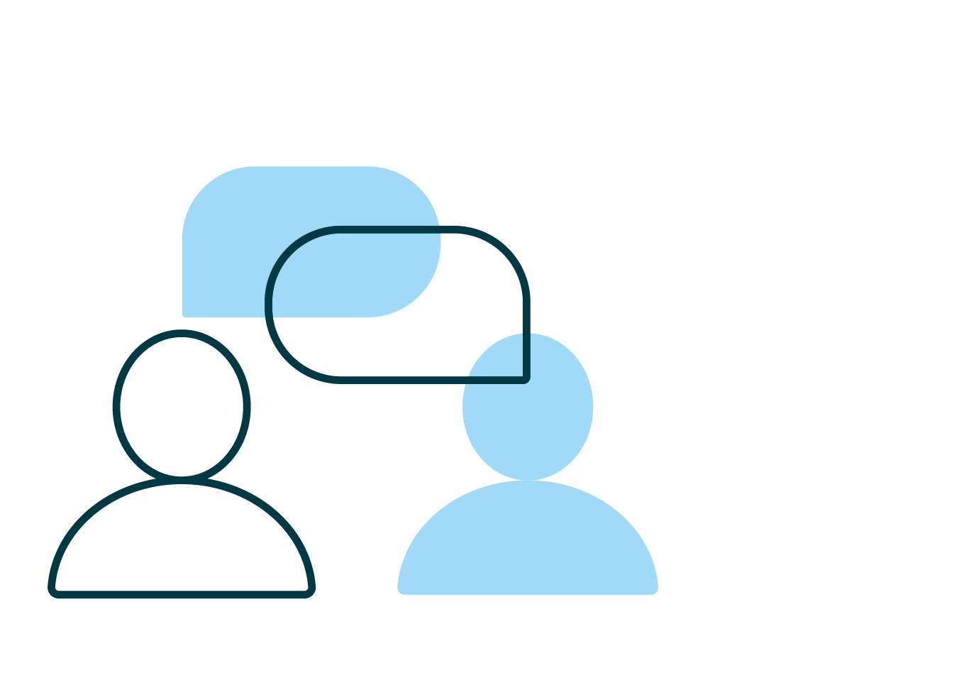
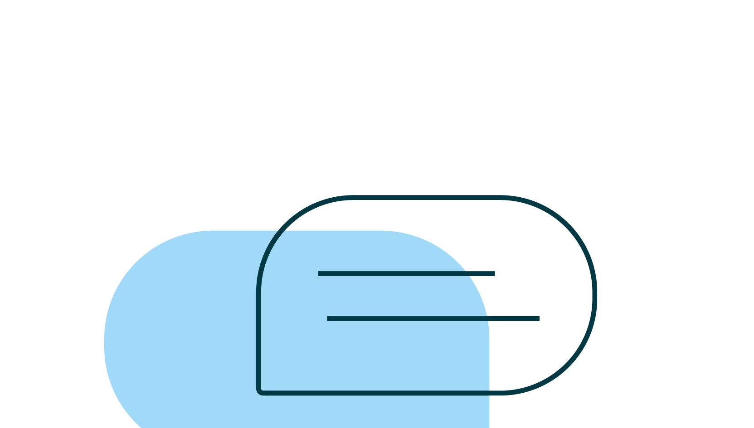
Argumentation with integrity
Lesson 4: Planning and drafting your essay - revising and editing
© 2022 Turnitin LLC. All rights reserved.
© 2021 Turnitin LLC. All rights reserved.
Notes:
Educator notes: We need to make our students aware that their own premises and biases are not fact. We thus require our students to challenge these premises and biases. Finally, we encourage them to discover and to challenge the premises and biases of others. In short, we move our students to experience some shift in their understanding.
Educator focus: moving from prewriting/planning to drafting your essay, revising and editing

Slide 2
Argumentation and the writing process
1 Choose a topic
2 Refine the topic
3 Begin preliminary research
4 Craft a claim
5 Locate and evaluate resources for credibility and inclusion of logical fallacies
6 Choose only the most credible sources
7 Record citations for all sources
8 Plan and draft your essay
9 Edit and revise your essay
© 2022 Turnitin LLC. All rights reserved.
Notes:
Educator notes:
This slide is an overview to help you review the basics of argumentation and the writing process with students.
Argumentation academic vocabulary linked here. You may wish to give students a copy for easy reference or post in an online class/website. You may wish to have students complete a preliminary vocabulary activity such as a Frayer model to make certain that students have a common understanding of the terms. Ideally they could then be posted in the room for easy reference.
Discuss each step of the process in terms of your current project and how students can work through each step of the process in your class. Consider revisiting the Argumentation writing process checklist with students at the beginning of each lesson.

Slide 3
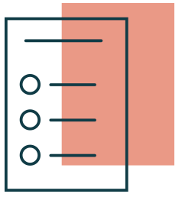
Argumentation with integrity: Lesson 4 objectives
Students will use completed research to draft their essay.
Students will revise and edit their essays to ensure that they have fully supported their claim.
Students will be able to use appropriate academic vocabulary as required by classroom activities.
© 2022 Turnitin LLC. All rights reserved.
Notes:
Educator notes: Review learning objectives -- if appropriate, add the content standards that match the objectives

Slide 4
What does academic integrity look like when applied to argumentation?
© 2022 Turnitin LLC. All rights reserved.
Notes:
Educator notes: Consider using this slide as a lesson starter to assess what students know about this at the beginning of the lesson OR as a formative assessment later in order to determine if the concept needs to be revisited after students have completed the lesson. If displaying this presentation to a whole class, record responses from students on this slide. Another option would be for students to work in collaborative groups to define, discuss, and create examples before sharing with the larger group. Remote option: share this slide with students and have them record their answers on it.

Slide 5
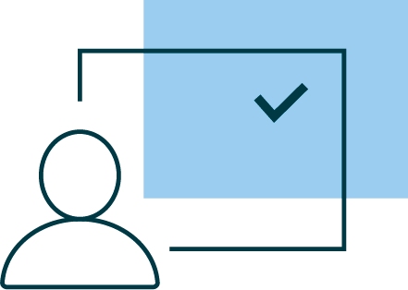
Plan your essay
Chosen and refined a topic?
Completed preliminary research?
Crafted a claim?
Located, evaluated, and chosen resources based on credibility? Avoided logical fallacies?
Recorded citations for all sources?
Your next step is to put together the information that you’ve gathered into a workable form.
© 2022 Turnitin LLC. All rights reserved.
Notes:
Educator notes: Review this slide as a reminder to students of all the steps they’ve taken up to this point to allow them to move into drafting.

Slide 6
What are arguments that can be made against my claim?
Now that you’ve decided on the best evidence to support your claim, it’s time to consider your counterclaim.
What are the best arguments against your claim?
How can you refute the counterclaim? Writing a strong rebuttal to a counterclaim is key to proving your claim.
© 2022 Turnitin LLC. All rights reserved.
Notes:
Educator notes: Now is a good time to introduce the Lesson 2 graphic organizer: What do I already know?. You may wish to model this process. Writing the claims and evidence and reasoning on this graphic organizer will allow students to see if they have located adequate credible information to support their claim as well as providing an organizational structure. You may wish to implement writing conferences or peer review at this stage to ensure that students are ready to write a first draft.

Slide 7
Draft your essay
First, review the instructions provided for the assignment to make sure that you fully understand the requirements.
Use the Lesson 4 graphic organizer: Pre-drafting while composing to ensure that your writing focuses on and includes:
Your claim
Evidence
Transition words/phrases
Logical organization of ideas
Counterclaim(s) and rebuttals
Concluding statement or paragraph
© 2022 Turnitin LLC. All rights reserved.
Notes:
Educator notes: Emphasize the use of the Lesson 4 graphic organizer: Pre-drafting that students have already completed in order to compose a first draft of the argument. Emphasize to students that they may need to provide further details in order to develop and support their claim. A comparison from the graphic organizer that you filled out with students in Lesson 2 compared to the corresponding paragraph from an essay might be a helpful support at this point.

Slide 8
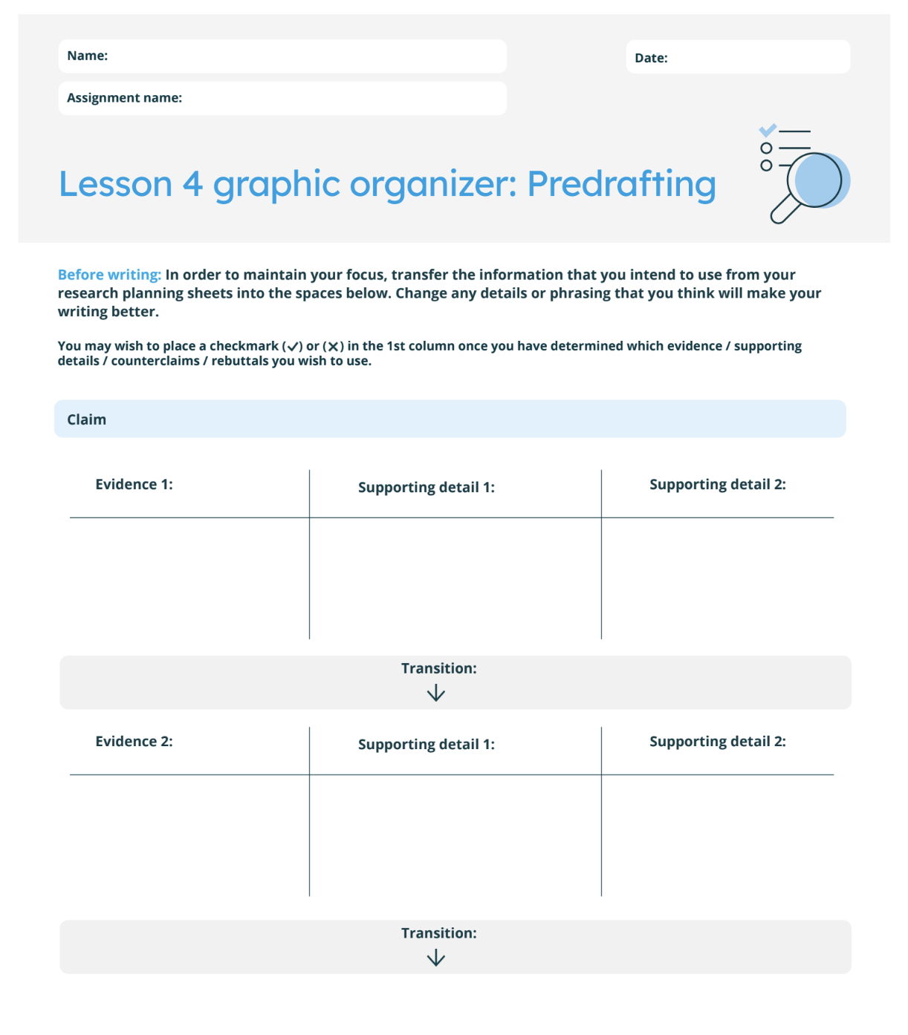
Plan your essay
© 2022 Turnitin LLC. All rights reserved.
Notes:
Educator notes: Students should have a copy (paper or electronic) of Lesson 4 graphic organizer: Pre-drafting in order to continue the drafting process. Use this slide to model how to fill out with the graphic organizer with students. Emphasize that this information has mostly been completed by them at this stage of the process. They should refer back to the worksheets/graphic organizers that they have already completed: Lesson 2 worksheet: Thesis or claim, Lesson 2 graphic organizer: What do I already know?, and various Research planning worksheets. You may need to refer to Turnitin’s list of transitional phrases in order to complete this graphic organizer.

Slide 9
So what now?
Even if a source “passes” all the tests and is deemed credible, what helps you determine whether you should use it or not?
Does this evidence say something different than other sources?
Are you just “piling on” sources because they are available?
Does this evidence support your thesis more clearly than other sources?
When choosing evidence, be careful to think about what explanations and reasoning you will use to make your use of evidence clear.
Eliminate any sources that don’t build the argument – no matter how tempting!
© 2022 Turnitin LLC. All rights reserved.
Notes:
Educator notes: Students may wish to include all sources in a first draft and eliminate them during the revision process once they see how their explanations work together to form a greater understanding and support for their thesis. Work with them during the drafting and revision processes to ensure that they aren’t just “bingeing” on evidence without providing explanations that tie it back to proving the thesis statement.

Slide 10
Revise and edit your draft
What skills are involved in revising and editing?
Revising refers to changes that you make that impact ideas, both as you are writing and after.
Adding, removing, or changing words and sentences to make meaning more precise and clear
Removing portions of your writing that distract or seem irrelevant to proving the claim
Rearranging sentences or paragraphs to make a greater impact
© 2022 Turnitin LLC. All rights reserved.
Notes:
Educator notes: Consider using the rubric or the How might I improve? self-assessment in peer groups. For students who may need more support, consider individual or small group writing conferences.
Once students have submitted the final draft, students should complete the How might I improve next time? Self assessment in order to examine their own processes.

Slide 11
Revise and edit your draft
What skills are involved in revising and editing?
Editing refers to changes that impact how you express those ideas in a clear manner.
Spelling
Capitalization
Paragraphs
Grammar
Usage
© 2022 Turnitin LLC. All rights reserved.
Notes:
Educator notes: Consider using the rubric or the How might I improve? self-assessment in peer groups. For students who may need more support, consider individual or small group writing conferences.
Once students have submitted the final draft, students should complete the How might I improve next time? Self assessment in order to examine their own processes.

Slide 12
How to best revise and edit a draft
Use the rubric to self-score. What areas of improvement does this suggest?
Now is a great time to use the How might I improve? self-assessment.
Working with a partner may make this process easier.
Carefully review all feedback and the rubric before revising and editing the draft a final time and submitting it.
Remember that you can--and should--revise multiple times prior to submitting your final draft.
© 2022 Turnitin LLC. All rights reserved.
Notes:
Educator notes: Consider using the rubric while conducting peer review or the How might I improve? self-assessment in peer groups. For students who may need more support, consider individual or small group writing conferences. Students should then make revisions based on recommendations from their own review, peers, and the educator. Tools such as Draft Coach, PeerMark, and Feedback Studio are helpful at multiple times during the drafting process. These tools will give students multiple opportunities to revise and edit work while streamlining much of the process for the educator.
Once students have submitted the final draft, students should complete the How might I improve next time? Self assessment.

Slide 13
Which stage of the writing process was most helpful to you in drafting your argument? Why and how was it most effective for you?
© 2022 Turnitin LLC. All rights reserved.
Notes:
Educator notes: Consider using this slide as a formative assessment in order to determine if the concept needs to be revisited after students have completed the lesson. If displaying this presentation to a whole class, record responses from students on this slide. Another option would be for students to work in collaborative groups to define, discuss, and create examples before sharing with the larger group. Remote option: share this slide with students and have them record their answers on it.

