Slide 1
Evaluating Source Credibility
Lesson 3: Purpose
Practice
Notes:
Preparation for this activity:
Goal: For students to practice evaluating the purpose of a source to determine its credibility.
Materials: Print copies of the coordinating practice worksheet for Lesson 3: Purpose. Share worksheets with each student/pair/group. Refer to the Source Credibility Guide for students to see where this lesson fits in the process.
About: This activity follows the process: Introduce, Model, and Student Practice. Review the slides before conducting the activity. Be sure to have planned for the sources to be evaluated during this activity (see next slide). Before the activity, decide if students should work independently, in partners, or in groups.
Recommendations/Modifications:
Consider conducting this activity as a complete practice unit. Begin by showing the overview video, then follow each video lesson with the practice activity. Have students keep their worksheets either stapled together, in a folder, or organized digitally.
Consider showing students several examples to help illustrate processes for evaluating ranges of credibility.
Depending on your class, you may decide to have students practice these steps with the same source. For more advanced students, consider asking students to choose their own sources for the activity.

Slide 2
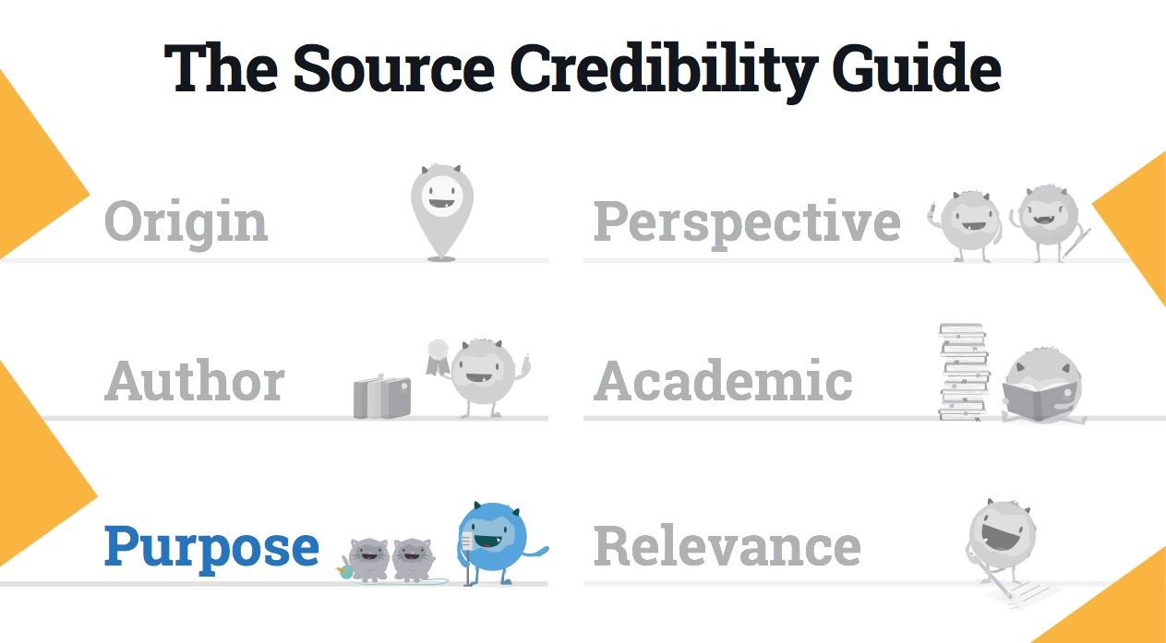
POSTER HERE
Notes:
Teacher Notes:
Here’s a view of the Source Credibility Guide. Help orient students with the categories by highlighting Purpose as the next step.
Consider also pointing out the category on the coordinating practice worksheet and/or classroom poster.

Slide 3
Source:
Notes:
Teacher Notes:
Introduce: Remind students you will be using a different source from them for this activity. However, they should continue using the same source they evaluated from Lesson 1.
Model: Explain how this activity will be completed using the same source. Record the source information on this slide.
Student practice: Instruct students locate their source and record the source information in their worksheets.

Slide 4
Audience
Who is the intended audience for this information?
Does the information educate readers? (hint: academic writing should have a clear bibliography that you will be able to consult for further sources)
Notes:
Teacher Notes:
Introduce: Highlight the Audience section. Explain how determining the intended audience can help figure out the purpose of the writing. Although it will be impossible to discover the real intended audience, students should try and make a guess on who the author is intending to read this information. Talk to students about what it may look like for sources to educate readers. For example, these sources will inform readers on a specific topic (the next few slides may also help students answer this question). Consider showing students examples and non-examples of sources with the intent to educate readers vs. sources that do not.
Model: Ask each question aloud and show students how you would find the answer to that question. Example, “Who is the intended audience for this writing? Well, I will take a look at my source and try to make an educated guess on who the author is trying to reach (consider showing several examples to demonstrate this thinking). Does the information educate readers? It seems like the writing is trying to…..” (Explain how academic writing should have references...model your thinking aloud.) (Instead of jotting findings on the worksheet, record answers on the slide to mimic the experience.)
Tip: Try to help students recognize strategies for determining the intended audience. Explain how the answer to this question may be more clear as they continue this lesson. Consider revisiting this question after answering the next few questions.
Student practice: Instruct students to walk through the same steps for their source and record answers in the worksheet. Give students time to complete their work.

Slide 5
Intention
Why was this information written? (Does the motive appear to be informational? Does the information display opinion? Does the information feel like entertainment? Or perhaps, persuasion? Does it appear like there is a motive to sell something?)
Notes:
Teacher Notes:
Introduce: Highlight the Intention section. This section will help students further determine the purpose of the writing. Review the different type of motives: inform, persuade, entertain, sell, etc. Explain what each of these motives means for credibility. For example, if the purpose is to entertain, persuade, or sell, the student should question the credibility of the source. For further practice, consider reviewing several websites with students and having them help you determine its motive together.
Model: Ask each question aloud and show students how you would find the answer to that question. Example, “Why was this information written? What is the motive?....Well, just by looking at this website, I can see there are several advertisements….” (Instead of jotting findings on the worksheet, record answers on the slide to mimic the experience.)
Student practice: Instruct students to walk through the same steps for their source and record answers in the worksheet. Give students time to complete their work.

Slide 6
Look Further: Factual or Persuasive
How much of the information appears to be factual? Does the author appear to want to change the reader’s mind?
If the author takes a position on the issue, are both sides (or counterclaims) presented fairly and in an accurate way?
Are graphics or imagery used to sway the opinion of the user? Do they sway the viewer? How?
Notes:
Teacher Notes:
Introduce: Highlight the Look Further section. Explain how answering the next few questions will further help students determine the purpose. Factual sources that present claims and counterclaims will be more credible. Help students understand sources may contain some, all, or no information that is factual. Students should be weary of sources using persuasive language or images to sway the reader.
Model: Ask each question aloud and show students how you would find the answer to that question. Example, “How much of the information appears to be factual or does the author appear to want to change the reader’s mind? Here, I’m trying to figure out if the information is persuasive or not. If it’s persuasive, I should probably question the motives of the source, therefore the credibility….” (Instead of jotting findings on the worksheet, record answers on the slide to mimic the experience.)
Student practice: Instruct students to walk through the same steps for their source and record answers in the worksheet. Give students time to complete their work.

Slide 7
Conclusions
So far, what can you conclude about the credibility of the source based on the purpose?
Notes:
Teacher Notes:
Highlight the section about conclusions in the worksheet. This is an important section! Now that students have recorded the basic information about the purpose of the source, help them make initial judgements on it credibility.
Model: Reflect back on the findings from the questions in this activity. Help students understand how to make initial judgements. For example, “Okay, so looking back at my source, I’ve learned _____ and _____ about the purpose…..” (Instead of jotting findings on the worksheet, record answers on the slide to mimic the experience.)
Student practice: Instruct students to record their conclusions about the credibility of this source based on the findings from Purpose.
Extended independent practice: After this modeled practice, consider having students practice Author evaluation on their own. Choose to either 1) Print another copy of the coordinating handout, or 2) Use the next slide for students to jot down answers on a blank piece of paper. Instruct students to walk through the steps with a different source on their own.

Slide 8
Practice: Evaluating Purpose
Source:
Author: Who is the author of the source?
Audience: Who is the intended audience for this information? Does the information educate readers? (Hint: academic writing should have a clear bibliography that you will also be able to consult for further sources)
Intention: Why was this information written? (Does the motive seem to be informational? Is it an opinion? Does it feel like entertainment? Persuasion? Does it seem like there is a motive to sell something?)
Look Further: Factual or Persuasive: Does the information seem to be factual, or does the author seem to want to change the reader’s mind? If the author takes a position on the issue, are both sides (or the counterclaim) presented fairly and in an accurate way? Are graphics or imagery used to sway the opinion of the user? Do they sway the viewer? How?
Based on these answers, what can you conclude about the credibility of the source?
Notes:
Teacher Notes:
This slide presents the questions from the coordinating handout. Present this slide as students investigate another source on their own.

Slide 9
The End

