Slide 1
Evaluating Source Credibility
Lesson 5: Is the Source Academic?
Practice
Notes:
Preparation for this activity:
Goal: For students to practice evaluating the scholarship of a source to determine its credibility. Remind students that some assignments will require scholarly sources and others will not. However, even if scholarly sources are not required, using these types of sources in your assignments will always strengthen their writing.
Materials: Print copies of the coordinating practice worksheet for Lesson 5: Academic. Share worksheets with each student/pair/group. Refer to the Source Credibility Guide for students to see where this lesson fits in the process.
About: This activity follows the process: Introduce, Model, and Student Practice. Review the slides before conducting the activity. Be sure to have planned for the sources to be evaluated during this activity (see next slide). Before the activity, decide if students should work independently, in partners, or in groups.
Recommendations/Modifications:
Consider conducting this activity as a complete practice unit. Begin by showing the overview video, then follow each video lesson with the practice activity. Have students keep their worksheets either stapled together, in a folder, or organized digitally.
Consider showing students several examples to help illustrate processes for evaluating ranges of credibility.
Depending on your class, you may decide to have students practice these steps with the same source. For more advanced students, consider asking students to choose their own sources for the activity.

Slide 2
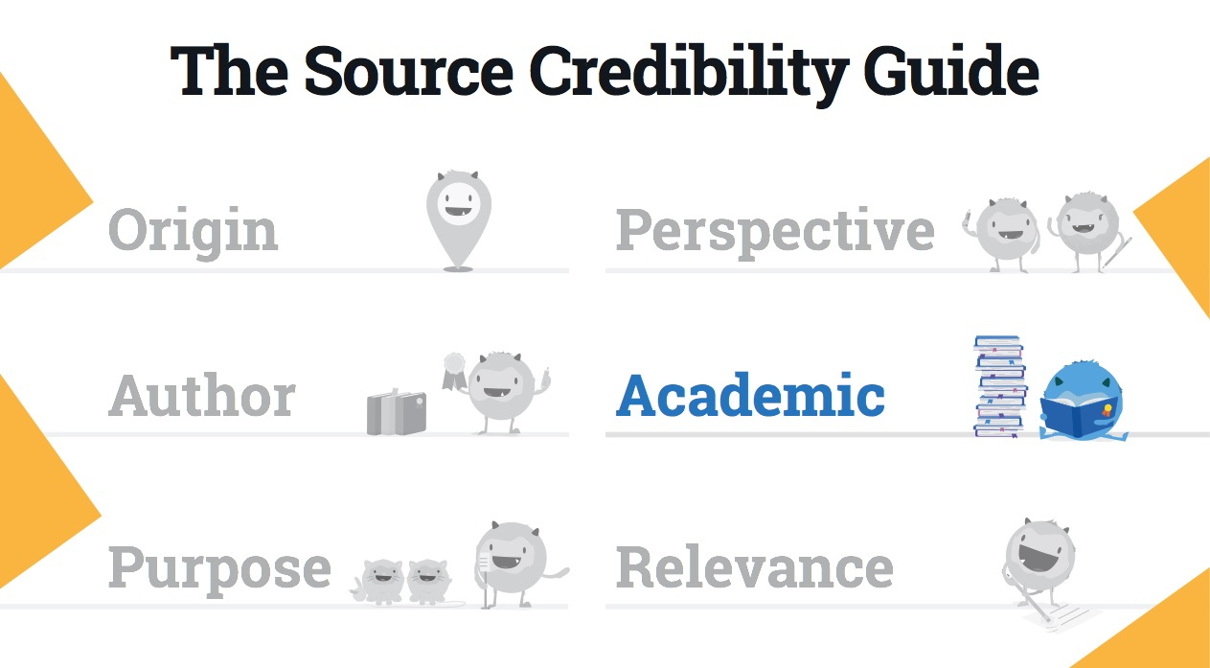
Notes:
Teacher Notes:
Here’s a view of the Source Credibility Guide. Help orient students with the categories by highlighting Academic as the next step.
Take a moment to explain to students how academic sources are also called scholarly sources. Both terms are applied during this activity.
Consider also pointing out the category on the coordinating practice worksheet and/or classroom poster.

Slide 3
Source:
Notes:
Teacher Notes:
Introduce: Remind students you will be using a different source from them for this activity. However, they should continue using the same source they evaluated from Lesson 1.
Model: Explain how this activity will be completed using the same source. Record the source information on this slide.
Student practice: Instruct students locate their source and record the source information in their worksheets.

Slide 4
Evidence
Is the information supported by evidence?
Notes:
Teacher Notes:
Introduce: Highlight the Evidence section. Take a minute to discuss what it means to be supported by evidence. Consider showing examples of sources with/without evidence. Explain how having evidence improves the credibility of the writing and points towards an academic source. Also, remind students to quickly review the supporting sources to make sure they seem credible themselves.
Model: Ask each question aloud and show students how you would find the answer to that question. Example, “Is the information supported by evidence? Well, I notice the author citing several sources in the writing...and I can see a reference list at the bottom...so I can conclude this information is supported by evidence.” (Instead of jotting findings on the worksheet, record answers on the slide to mimic the experience.)
Student practice: Instruct students to walk through the same steps for their source and record answers in the worksheet. Give students time to complete their work. Consider having students share some of their ideas.

Slide 5
Peer-reviewed or published
Is the source peer-reviewed or published?
Notes:
Teacher Notes:
Introduce: Highlight the Peer-reviewed or Published section. This section will help students further determine the scholarship of the writing. Take a moment to explain peer-reviewed means the source was evaluated and validated by another expert in the same field, with similar competencies. Most academic journals require all sources to be peer-reviewed before publication. However, it is not always the case. Sources that are published will be found in academic journals or academic texts. Peer reviewed or published work would most often qualify as scholarly and increase the ranking in source credibility. Determining if a source is peer-reviewed will vary. Sometimes the information is easily located somewhere in the beginning of the source. Sometimes peer-reviewed sources will say “refereed” or have a representative symbol. You may need to search for the source in a search engine (such as a local library database) to determine this information. Consider showing examples of peer-reviewed sources and how to determine that information. Also, show examples of published sources.
Model: Ask each question aloud and show students how you would find the answer to that question. Example, “Is the source peer-reviewed or published? I can tell this source was published in a peer-reviewed journal because I see this information here…..” (Instead of jotting findings on the worksheet, record answers on the slide to mimic the experience.)
Student practice: Instruct students to walk through the same steps for their source and record answers in the worksheet. Give students time to complete their work.

Slide 6
Professional
Is the source free from errors and/or inappropriate language?
Notes:
Teacher Notes:
Introduce: Highlight the Professional section. Take a moment to explain how academic sources should be free from obvious spelling and grammar errors, or inappropriate language. If slang or several editing mistakes are found, it is viable to be questioning the scholarship of the text. Consider showing examples of sources containing grammar/slang so students grasp the concept.
Model: Ask each question aloud and show students how you would find the answer to that question. Example, “Is the source free from errors and/or inappropriate language? Well, looking closely at the writing I notice…” (Instead of jotting findings on the worksheet, record answers on the slide to mimic the experience.)
Student practice: Instruct students to walk through the same steps for their source and record answers in the worksheet. Give students time to complete their work.

Slide 7
Conclusions
So far, what can you conclude about the credibility of the source based on its scholarship?
Notes:
Teacher Notes:
Highlight the section about conclusions in the worksheet. This is an important section! Now that students have recorded the basic information about the scholarship of the source, help them make judgements on it credibility.
Model: Reflect back on the findings from the questions in this activity. Help students understand how to make judgements. For example, “Okay, so looking back at my source, I’ve learned _____ and _____ about the scholarship of this source…..” (Instead of jotting findings on the worksheet, record answers on the slide to mimic the experience.)
Student practice: Instruct students to record their conclusions about the credibility of this source based on the findings from Academic.
Extended independent practice: After this modeled practice, consider having students practice Author evaluation on their own. Choose to either 1) Print another copy of the coordinating handout, or 2) Use the next slide for students to jot down answers on a blank piece of paper. Instruct students to walk through the steps with a different source on their own.

Slide 8
Practice: Evaluating Scholarly Sources
Source:
Evidence: Is the information supported by evidence?
Peer-reviewed or Published: Is the source peer reviewed or published?
Professional: Is the source free from errors and/or inappropriate language?
Based on these answers, what can you conclude about the credibility of the source?
Notes:
Teacher Notes:
This slide presents the questions from the coordinating handout. Present this slide as students investigate another source on their own.

Slide 9
The End

